Slide 1
Developing YARN Native Applications
Arun Murthy – Architect / Founder
Bob Page – VP Partner Products

Slide 2
Topics
Hadoop 2 and YARN: Beyond Batch
YARN: The Hadoop Resource Manager
YARN Concepts and Terminology
The YARN APIs
A Simple YARN application
The Application Timeline Server
Next Steps

Slide 3
Hadoop 2 and YARN: Beyond Batch

Slide 4
Hadoop 2.0: From Batch-only to Multi-Workload
Single Use System
Batch Apps
Multi Purpose Platform
Batch, Interactive, Online, Streaming, …
HADOOP 1.0
HADOOP 2.0
MapReduce
(data processing)
Others
(data processing)
MapReduce
(cluster resource management
& data processing)
YARN
(cluster resource management)
HDFS
(redundant, reliable storage)
HDFS2
(redundant, reliable storage)

Slide 5

Key Driver Of Hadoop Adoption: Enterprise Data Lake
Flexible Enables other purpose-built data processing models beyond MapReduce (batch), such as interactive and streaming
Efficient Double processing IN Hadoop on the same hardware while providing predictable performance & quality of service
Shared Provides a stable, reliable, secure foundation and shared operational services across multiple workloads
Data Processing Engines Run Natively IN Hadoop
BATCH
MapReduce
INTERACTIVE
Tez
ONLINE
HBase, Accumulo
STREAMING
Storm
IN-MEMORY
Spark
GRAPH
Giraph
OTHERS
YARN: Cluster Resource Management
HDFS: Redundant, Reliable Storage

Slide 6
5 Key Benefits of YARN
5
Scale
New Programming Models & Services
Improved Cluster Utilization
Agility
Beyond Java

Slide 7
YARN Platform Benefits
Deployment
YARN provides a seamless vehicle to deploy your software to an enterprise Hadoop cluster
Fault Tolerance
YARN ‘handles’ (detects, notifies, and provides default actions) for HW, OS, JVM failure tolerance
YARN provides plugins for the app to define failure behavior
Scheduling (incorporating Data Locality)
YARN utilizes HDFS to schedule app processing where the data lives
YARN ensures that your apps finish in the SLA expected by your customers

Slide 8
A Brief History of YARN
Originally conceived & architected at Yahoo!
Arun Murthy created the original JIRA in 2008 and led the PMC
The team at Hortonworks has been working on YARN for 4 years
90% of code from Hortonworks & Yahoo!
YARN battle-tested at scale with Yahoo!
In production on 32,000+ nodes
YARN Released October 2013 with Apache Hadoop 2

Slide 9
YARN Development Framework
Applications
ISV
Apps
Direct
ISV
Apps
Scripting
Pig
SQL
Hive
Cascading
Java
Scala
NoSQL
HBase
Accumulo
Stream
Storm
API
ISV
Apps
ISV
Aps
Others
Spark
ISV Apps
Batch
MapReduce
Interactive
Tez
Real-Time
Slider
Engine
YARN : Data Operating System
System
HDFS (Hadoop Distributed File System)
1
°
°
°
°
°
°
°
°
°
°
°
°
°
°
°
°
°
°
°
°
°
°
°
°
°
°
°
°
°
°
°
°
°
°
N

Slide 10
YARN Concepts

Slide 11
Apps on YARN: Categories
Type | Definition | Examples
Framework / Engine | Provides platform capabilities to enable data services and applications | Twill, Reef, Tez, MapReduce, Spark
Service | An application that runs continuously | Storm, HBase, Memcached, etc
Job | A batch/iterative data processing job that runs on a Service or a Framework | XML Parsing MR job Mahout K-means algorithm
YARN App | A temporal job or a service submitted to YARN | HBase Cluster (service) MapReduce job

Slide 12
YARN Concepts: Container
Basic unit of allocation
Fine-grained resource allocation
memory, CPU, disk, network, GPU, etc.
container_0 = 2GB, 1CPU
container_1 = 1GB, 6 CPU
Replaces the fixed map/reduce slots from Hadoop 1
Capability
Memory, CPU
Container Request
Capability, Host, Rack, Priority, relaxLocality
Container Launch Context
LocalResources - Resources needed to execute container application
Environment variables - Example: classpath
Command to execute

Slide 13
YARN Terminology
ResourceManager (RM) – central agent
Allocates & manages cluster resources
Hierarchical queues
NodeManager (NM) – per-node agent
Manages, monitors and enforces node resource allocations
Manages lifecycle of containers
User Application
ApplicationMaster (AM)
Manages application lifecycle and task scheduling
Container
Executes application logic
Client
Submits the application
Launching the app
Client requests ResourceManager to launch ApplicationMaster Container
ApplicationMaster requests NodeManager to launch Application Containers

Slide 14
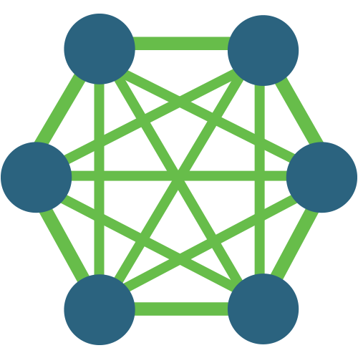


YARN Process Flow - Walkthrough
ResourceManager
Client₂
Scheduler
NodeManager
NodeManager
NodeManager
NodeManager
Container _{1.1}
Container _{2.2}
Container _{2.4}
NodeManager
NodeManager
NodeManager
NodeManager
AM ₁
Container _{1.2}
AM₂
Container _{2.1}
NodeManager
NodeManager
NodeManager
NodeManager
Container _{1.3}
Container _{2.3}

Slide 15
The YARN APIs

Slide 16
APIs Needed
Only three protocols
Client to ResourceManager
Application submission
ApplicationMaster to ResourceManager
Container allocation
ApplicationMaster to NodeManager
Container launch
Use client libraries for all 3 actions
Package org.apache.hadoop.yarn.client.api
provides both synchronous and asynchronous libraries
Client
Resource
Manager
YarnClient
Application Client
Protocol
Application Master
Application Master
Protocol
AMRMClient
NMClient
Container Management
Protocol
Node Manager
Node Manager
Node Manager
App
Container

Slide 17
YARN – Implementation Outline
Write a Client to submit the application
Write an ApplicationMaster (well, copy & paste)
“DistributedShell is the new WordCount”
Get containers, run whatever you want!

Slide 18
YARN – Implementing Applications
What else do I need to know?
Resource Allocation & Usage
ResourceRequest
Container
ContainerLaunchContext & LocalResource
ApplicationMaster
ApplicationId
ApplicationAttemptId
ApplicationSubmissionContext

Slide 19
YARN – Resource Allocation & Usage
ResourceRequest
Fine-grained resource ask to the ResourceManager
Ask for a specific amount of resources (memory, CPU etc.) on a specific machine or rack
Use special value of * for resource name for any machine
ResourceRequest
priority
resourceName
capability
numContainers

Slide 20
YARN – Resource Allocation & Usage
Container
The basic unit of allocation in YARN
The result of the ResourceRequest provided by ResourceManager to the ApplicationMaster
A specific amount of resources (CPU, memory etc.) on a specific machine
Container
containerId
resourceName
capability
tokens

Slide 21
YARN – Resource Allocation & Usage
ContainerLaunchContext & LocalResource
The context provided by ApplicationMaster to NodeManager to launch the Container
Complete specification for a process
LocalResource is used to specify container binary and dependencies
NodeManager is responsible for downloading from shared namespace (typically HDFS)
ContainerLaunchContext
container
commands
environment
localResources
LocalResource
uri
type

Slide 22
The ApplicationMaster
The per-application controller aka container_0
The parent for all containers of the application
ApplicationMaster negotiates its containers from ResourceManager
ApplicationMaster container is child of ResourceManager
Think init process in Unix
RM restarts the ApplicationMaster attempt if required (unique ApplicationAttemptId)
Code for application is submitted along with Application itself

Slide 23
ApplicationSubmissionContext
ApplicationSubmissionContext is the complete specification of the ApplicationMaster
Provided by the Client
ResourceManager responsible for allocating and launching the ApplicationMaster container
ApplicationSubmissionContext
resourceRequest
containerLaunchContext
appName
queue

Slide 24
YARN Application API - Overview
hadoop-yarn-client module
YarnClient is submission client API
Both synchronous & asynchronous APIs for resource allocation and container start/stop
Synchronous: AMRMClient & AMNMClient
Asynchronous: AMRMClientAsync & AMNMClientAsync

Slide 25
YARN Application API – YarnClient
createApplication to create application
submitApplication to start application
Application developer provides ApplicationSubmissionContext
APIs to get other information from ResourceManager
getAllQueues
getApplications
getNodeReports
APIs to manipulate submitted application e.g. killApplication

Slide 26
YARN Application API – The Client
New Application Request: YarnClient.createApplication
1
ResourceManager
Client₂
Submit Application:
YarnClient.submitApplication
2
Scheduler
NodeManager
NodeManager
NodeManager
NodeManager
Container _{1.1}
Container _{2.2}
Container _{2.4}
NodeManager
NodeManager
NodeManager
NodeManager
AM ₁
Container _{1.2}
AM₂
Container _{2.1}
NodeManager
NodeManager
NodeManager
NodeManager
Container _{1.3}
Container _{2.3}

Slide 27
AppMaster-ResourceManager API
AMRMClient - Synchronous API
registerApplicationMaster unregisterApplicationMaster
Resource negotiation
addContainerRequest removeContainerRequest releaseAssignedContainer
Main API – allocate
Helper APIs for cluster information
getAvailableResources
getClusterNodeCount
AMRMClientAsync – Asynchronous
Extension of AMRMClient to provide asynchronous CallbackHandler
Callback interaction model with ResourceManager
onContainersAllocated
onContainersCompleted
onNodesUpdated
onError
onShutdownRequest

Slide 28
AppMaster-ResourceManager flow
AMRMClient.allocate
ResourceManager
Container
Scheduler
3
NodeManager
NodeManager
NodeManager
NodeManager
NodeManager
NodeManager
NodeManager
2
unregisterApplicationMaster
4
AM
1
registerApplicationMaster
NodeManager
NodeManager
NodeManager
NodeManager

Slide 29
AppMaster-NodeManager API For AM to launch/stop containers at NodeManager
AMNMClient - Synchronous API
Simple (trivial) APIs
startContainer
stopContainer
getContainerStatus
AMNMClientAsync – Asynchronous
Simple (trivial) APIs
startContainerAsync
stopContainerAsync
getContainerStatusAsync
Callback interaction model with NodeManager
onContainerStarted
onContainerStopped
onStartContainerError
onContainerStatusReceived

Slide 30
YARN Application API - Development
Un-Managed Mode for ApplicationMaster
Run the ApplicationMaster on your development machine rather than in-cluster
No submission client needed
Use hadoop-yarn-applications-unmanaged-am-launcher
Easier to step through debugger, browse logs etc.
$ bin/hadoop jar hadoop-yarn-applications-unmanaged-am-launcher.jar \
Client \
–jar my-application-master.jar \
–cmd ‘java MyApplicationMaster <args>’

Slide 31
A Simple YARN Application

Slide 32
A Simple YARN Application
Simplest example of a YARN application – get n containers, and run a specific Unix command on each. Minimal error handling, etc.
Control Flow
User submits application to the Resource Manager
Client provides ApplicationSubmissionContext to the Resource Manager
App Master negotiates with Resource Manager for n containers
App Master launches containers with the user-specified command as ContainerLaunchContext.commands
Code: https://github.com/hortonworks/simple-yarn-app

Slide 33
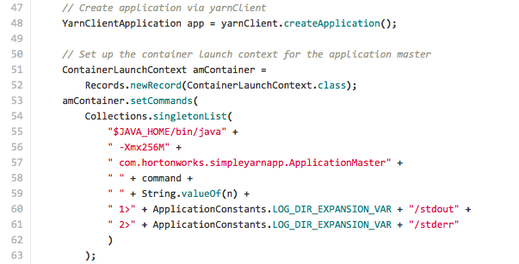
Simple YARN Application – Client
Command to launch ApplicationMaster process

Slide 34
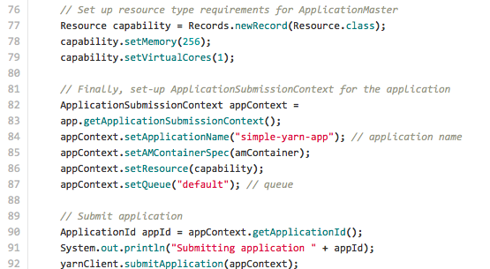
Simple YARN Application – Client
Resources required for ApplicationMaster container
ApplicationSubmissionContext
for
ApplicationMaster
Submit application to ResourceManager

Slide 35
Simple YARN Application – AppMaster
Steps:
AMRMClient.registerApplication
Negotiate containers from ResourceManager by providing ContainerRequest to AMRMClient.addContainerRequest
Take the resultant Container returned via subsequent call to AMRMClient.allocate, build ContainerLaunchContext with Container and commands, then launch them using AMNMClient.launchContainer
Use LocalResources to specify software/configuration dependencies for each worker container
Wait till done… AllocateResponse.getCompletedContainersStatuses from subsequent calls to AMRMClient.allocate
AMRMClient.unregisterApplication

Slide 36
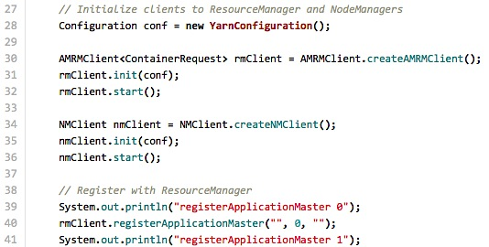
Simple YARN Application – AppMaster
Initialize clients to ResourceManager and NodeManagers
Initialize clients to ResourceManager and NodeManagers
Register with ResourceManager

Slide 37
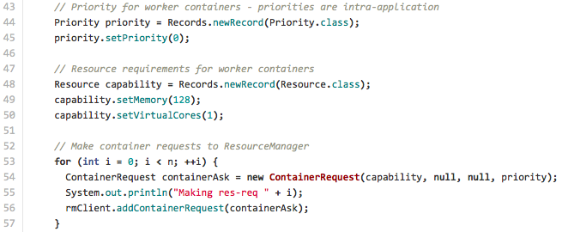
Simple YARN Application – AppMaster
Setup requirements for worker containers
Make resource requests to ResourceManager

Slide 38
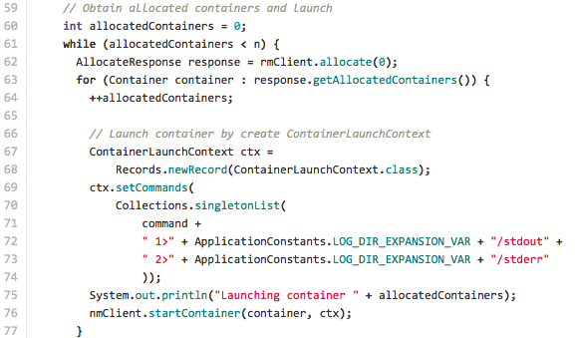
Simple YARN Application – AppMaster
Get containers from ResourceManager
Launch containers on NodeManagers

Slide 39
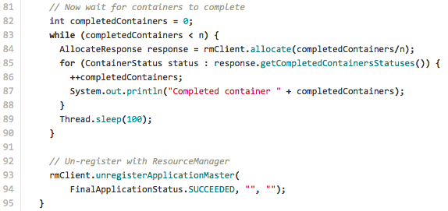
Simple YARN Application – AppMaster
Wait for containers to complete successfully
Un-register with ResourceManager

Slide 40
Graduating from simple-yarn-app
DistributedShell. Same functionality but less simple
e.g. error checking, use of timeline server
For a complex YARN app, see Tez
Pre-warmed containers, sessions, etc.
Look at MapReduce for even more excitement
Data locality, fault tolerance, checkpoint to HDFS, security, isolation, etc
Intra-application priorities (maps vs reduces) need complex feedback from ResourceManager
(all at apache.org)

Slide 41
Application Timeline Server

Slide 42
Application Timeline Server
Maintains historical state & provides metrics visibility for YARN apps
Similar to MapReduce Job History Server
Information can be queried via REST APIs
Generic information
queue name
user information
information about application attempts
a list of Containers that were run under each application attempt
information about each Container
Per-framework/application info
Developers can publish information to the Timeline Server via the TimelineClient (from within a client), the ApplicationMaster, or the application's Containers.
ATS in HDP 2.1 is considered a Tech Preview

Slide 43
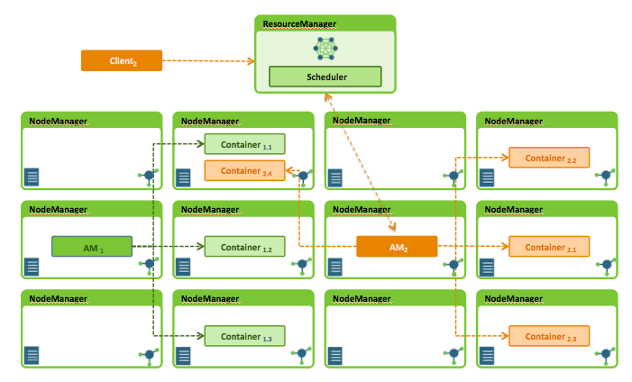


Application Timeline Server
AMBARI
App Timeline Server
Custom App Monitoring Client

Slide 44
Next Steps

Slide 45
hortonworks.com/get-started/YARN
Setup HDP 2.1 environment
Leverage Sandbox
Review Sample Code & Execute Simple YARN Application
https://github.com/hortonworks/simple-yarn-app
Graduate to more complex code examples
BUILD FLEXIBLE, SCALABLE, RESILIENT & POWERFUL APPLICATIONS TO RUN IN HADOOP

Slide 46
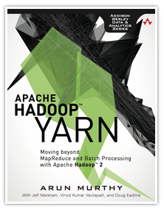
Hortonworks YARN Resources
Hortonworks Web Site
hortonworks.com/hadoop/yarn
Includes links to blog posts
YARN Forum
Community of Hadoop YARN developers – collaboration and Q&A
hortonworks.com/community/forums/forum/yarn
YARN Office Hours
Dial in and chat with YARN experts
Next Office Hour: Thursday August 14 @ 10-11am PDT. Register:
https://hortonworks.webex.com/hortonworks/onstage/g.php?t=a&d=628190636

Slide 47

And from Hortonworks University
Hortonworks Course: Developing Custom YARN Applications
Format: Online
Duration: 2 Days
When: Aug 18th & 19th (Mon & Tues)
Cost: No Charge to Hortonworks Technical Partners
Space: Very Limited
Interested? Please contact lsensmeier@hortonworks.com

Slide 48
Stay in Touch!
Join us for the full series of YARN development webinars:
YARN Native July 24 @ 9am PT (recording link)
Slider August 7 @ 9am PT (registration link)
Tez August 21 @ 9am PT (registration link)
Additional webinar topics are being added – watch the blog or visit Hortonworks.com/webinars
http://hortonworks.com/hadoop/yarn

